Slide 1


Create Reports
Please mute yourself. Thank you!

Slide 2
Learning Objectives
You will learn the following concepts:
Design a Report
Enhance a Report
Notes:
By the end of this module, you’ll be able to:
Design a report, including report layout, adding built-in and custom visuals, and adding basic report functionality.
Enhancing a report, including improving performance, adding navigation and interactions, and implementing buttons and bookmarks.

Slide 3
Module Agenda
Design a Report
Enhance the Report

Slide 4
Lesson 1: Design a Report

Slide 5
Introduction
Visuals allow you to share data insights more effectively.
Effective visualizations help your users connect and interact with the information.
Notes:
Power BI visuals are attractive charts and graphics that you can use to revitalize your data. Visuals allow you to share data insights more effectively and increase comprehension, retention, and appeal. Visuals are a fundamental part of your report because they help your report audience connect and interact with the information to make informed decisions quickly.
After you've loaded and modeled your organization's data in Power BI Desktop, you will be ready to start creating your reports. In this module, you'll use the report editor in Power BI Desktop to add suitable visuals to your report canvas. You'll then customize those visuals to meet your organization's requirements.

Slide 6
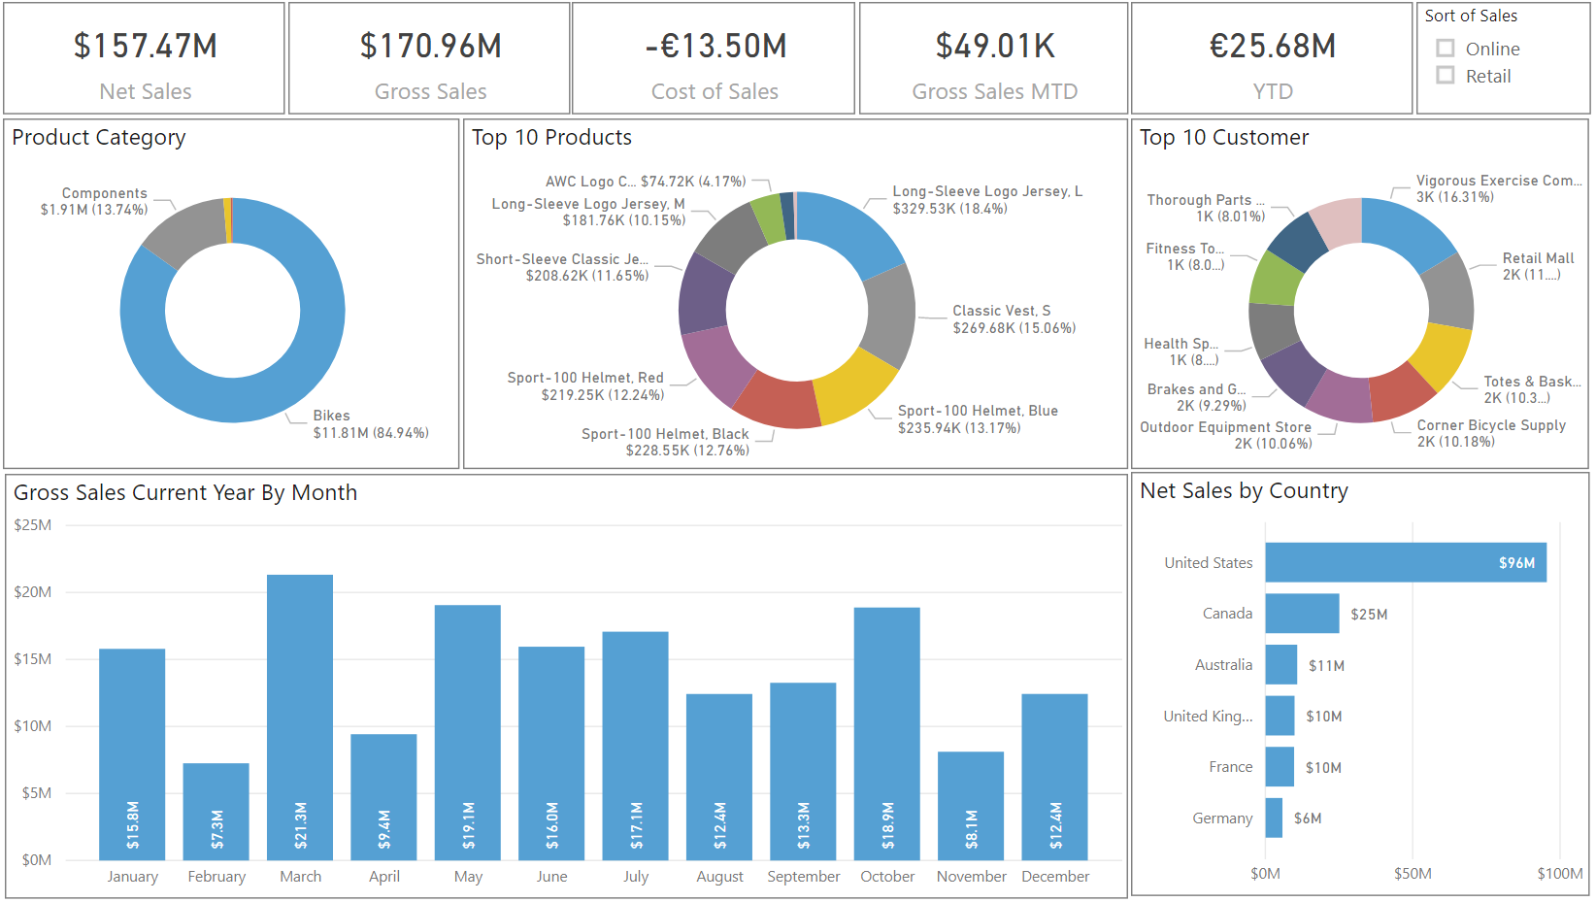
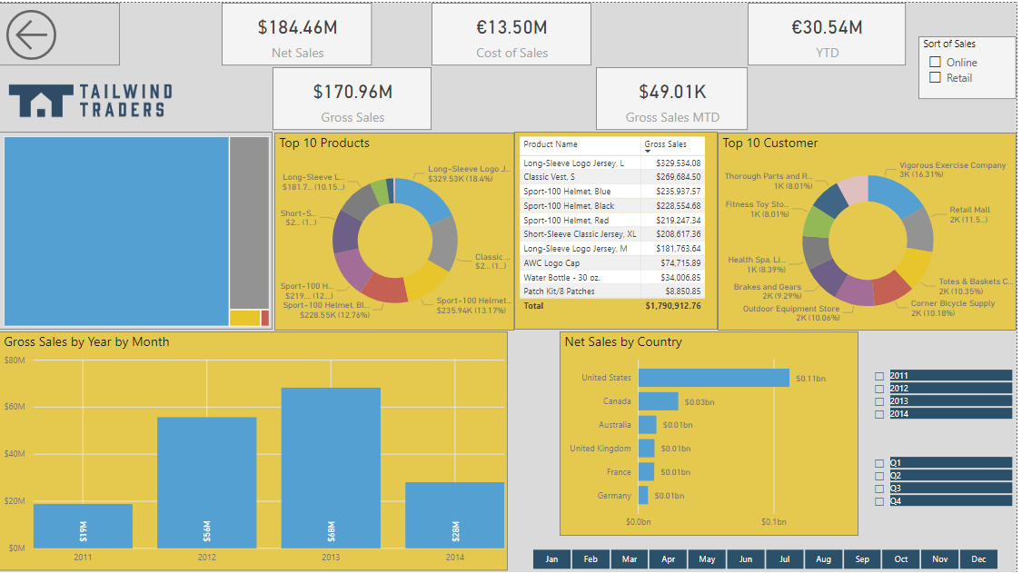
Design a Report Layout
Notes:
The page layout of the reports you create in Power BI Desktop will likely depend on the business requirements, the context of the underlying data, and the output requirements. For example, if you are designing a dashboard, you'll need to present high-level information on a single page. If you are designing a report, it is a multi-perspective view into your dataset, with visuals that represent different findings and insights from that dataset.
This is an example of a badly designed layout; something you should avoid.
This is an example of a badly designed report. What is wrong with this report?
<Click>
When designing a report layout (best practices):
Choose the correct format: Collaborate with stakeholders to understand the requirements for the report, including format, data to display, etc.
Consider the audience of your report: This is critical on many levels. Your goal is to provide the audience with the information they need, in the most optimal way.
Consider the different needs that the end user may have: End users of your report might have hearing, motor, cognitive, or visual impairment. To cater for those needs, you'll have to create a report that offers an accessible experience, which means it is easy to navigate and understand by keyboard or screen reader users.
Consider the visuals and elements: Carefully consider each visual and element that you plan on using in the report. Everything should have a purpose, and you should consider how each element will look to your report users. Oftentimes, simplest is best.
Key guidelines:
Draw a sketch: Draw a sketch of your report layout, so you can get a quick picture of what will look like, before you spend lots of time physically designing it.
Information: Focus on the most important information. Highlight key parts of your report with a bright color or summary icon, so that it stands out, and users drawn to the most critical metrics.
Design: Select the right background for the context of your report. It is said that a white background makes your report look clean and business-like, a black background draws the eye to colorful highlights on the report, and an image used as a background adds numerous feeling.
Report page: It is important to consider that you and the report users might view the reports on screens with different aspect ratios and sizes.

Slide 7
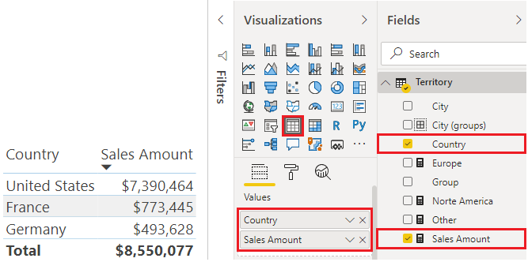
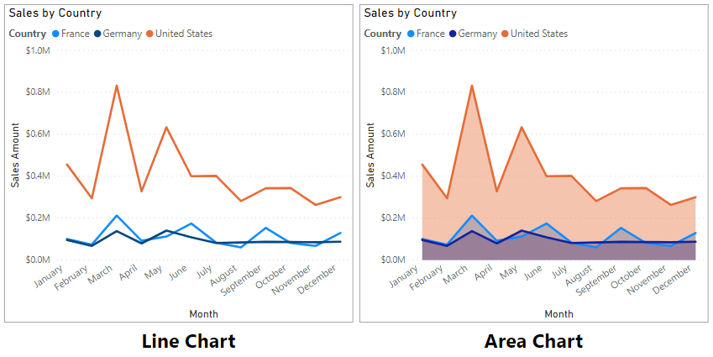
Choosing Effective Visualizations
The right visual makes all the difference.
You may have drilldown functionality to display the trends over a period of time
Notes:
It is important that you choose an effective visualization to ensure that you display the data in the best way possible. Power BI has over 30 visuals, so electing the right visual is critical in telling a compelling story with the data and helping users quickly gain insights from the report.
When you select the fields that you want to display in a visualization, you can experiment with all the different visualization types to find the one that best suits your needs. If you can't find a visual that meets your needs, you can download other visuals from Microsoft AppSource or import your own custom visuals.
Power BI includes the following out-of-the-box visuals:
Table and Matrix: The table is a grid that contains related data in a logical series of rows and columns. The table supports two dimensions and the data is flat, which means that duplicate values are displayed and not aggregated. The Matrix visualization looks similar to the table visualization; however, it allows you to select one or more elements (rows, columns, values) in the matrix to cross-highlight other visuals on the report page.
Bar and column charts: Power BI Desktop has a variety of bar and column chart visualizations that present specific data across different categories in a stacked or clustered format. The stacked format will stack the information items on top of each other.
Line and area charts: Help you present trends over time. The basic area chart is based on the line chart, with the area between axis and line filled in. The main difference between these two chart types is that the area chart highlights the magnitude of change over time.
Pie and donut charts: Show you the relationship of parts to the whole by dividing the data into segments. From a data analysis perspective, these charts are not useful because interpreting the data that they present can be difficult. Best used for illustrating percentages.
Treemaps: Displays data as set of nested rectangles. It falls into the same category as the pie and donut charts in terms of their data analysis usefulness, but is useful if you want to show attributes by using size and color coding, spot patterns, exceptions, or outliers, or you have large amounts of hierarchical data and a bar chart can’t handle the large number of values.
Combo charts: Is a combination of a column chart and a line chart that can have one or two Y axes. This chart lets you illustrate correlations between two measures in a single visual, compare multiple measures with different value ranges, and conserve space on a report.
Cards: Displays a single value: a single data point. This type of visualization is deal for visualizing important statistics that you want to track on your Power BI dashboard or report, such as total value, YTD sales, or year-over-year change.
Funnel: Displays a linear process that has sequential connected stages, where items flow sequentially from one stage to the next. Useful when the data is sequential, you want to calculate outcomes by stages, or revealing bottlenecks in a linear process.
Gauge: A radial gauge chart has a circular arc and displays a single value that measures progress toward a goal or target.
Waterfall: The waterfall visualization (also known as a bridge chart) shows a running total as values are added or subtracted, which is useful in displaying a series of positive and negative changes.
Scatter: The scatter chart visualization is effective when you are comparing large numbers of data points without regard to time.
Maps: A Bubble map displays precise geographical locations of data points on a map. A Fill map uses shading, tinting, or patterns to display how a value differs in proportion across a geographical region. A Shape map use colors to display relative comparisons of geographical regions.
Slicer: Used to filter the other visuals on the page. Slicers provide a more advanced and customized way of filtering, in comparison to the Filters pane, which is suited to more basic filtering operations. Different types: list, dropdown, buttons.
Q&A: allows you to ask natural language questions and get answers in the form of a visual.

Slide 8
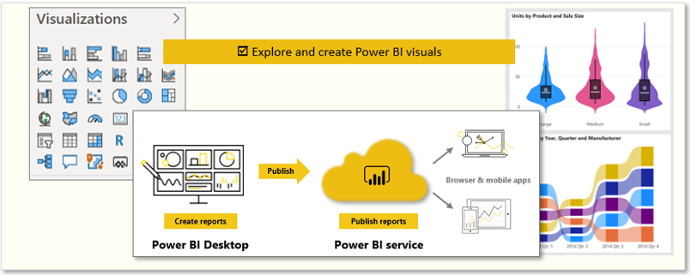
Adding Visualizations to Reports
Notes:
Power BI has a variety of visuals that you can use to report on the data in your data model. Visuals allow you to present the important information and insights that you discovered in the data in a compelling and insightful way. The report consumers rely on these visualizations as a gateway to the underlying data.
In Power BI Desktop, each visual is represented by an icon in the Visualizations pane. The types of visuals that are available include charts, maps, cards, a table, a matrix, and many more.
Start by selecting the fields from the Fields pane that you want to display on the report. Power BI Desktop then automatically selects a visualization for you, depending on the data type of the fields that you selected. While the visual is selected, you can change the visualization type by selecting a different visual from the Visualizations pane.
Visuals considerations:
Type: You might want to use a combination of visuals in your report, such as cards, charts, tables, slicers, and so on. It is important to use the right number of visuals on a page, and then size and position those visuals in the best way.
Number: Consider the number of visuals (including slicers) that you want to use on each report page. It's best to limit the number of visuals you use on a page. More visuals might have the opposite effect to what you are trying to achieve. Rather than using multiple visuals, you can provide information in other ways, such as drill through pages and report page tooltips.
Position: As you add visualizations, move those visuals to specific locations on the page, and make them bigger or smaller for a more effective display. It is best practice to place the most important visual in the top-left corner of your report, as your report users will most likely from read left to right, and top to bottom.
Size: Power BI determines the size of that visual by default, but you can resize visuals to present the information it displays in the most optimal way.
Interaction: The visuals that you add to your report will interact with each other, in that, selecting an element in one visual will update other visuals in relation to your selection. As you design a report, it is important to understand visual interaction and consider how they might affect the overall user experience of the report.
Hierarchies: Consider how hierarchies will affect how the data displays in the visuals, and the navigation experience of your report users. You can also determine the hierarchical path of visuals, so you have full control over what level of detail can be accessed.

Slide 9
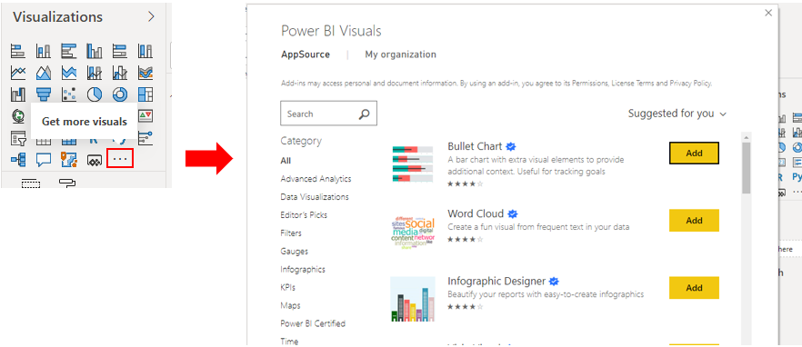
Import a Custom Visual
Custom visuals is required to be imported each time you want to use it when you are developing a new report
Use visuals tailored for your needs.
Notes:
In addition to the out-of-the-box visualizations in Power BI Desktop, hundreds of other developers have created a multitude of visuals for you to choose from. If you have a specific visual in mind, you can likely find it in the marketplace. If you can't find it, Power BI makes it possible for you to build your own.
The custom visuals that are available in Microsoft AppSource are created by Microsoft and Microsoft partners. Some of these custom visuals are certified and some are not. The certified status means that the visual meets the Microsoft Power BI team code requirements; the visual is tested to verify that it doesn't access external services or resources and that it follows secure coding patterns and guidelines. The certification process is optional, so an uncertified visual is not necessarily unsafe to use.
If you want to create your own custom visual, you can use the custom visual software development kit (SDK), which is an open-source tool based on NodeJS (JavaScript programming language) that is available on GitHub. The custom visual is packaged as a single Power BI Visual Tools (.pbiviz) file that you can import into Power BI Desktop.
In the Visualizations pane, select the Get more visuals icon and then select Get more visuals. On the window that displays, locate and select the visual that you want to import and then select Add.
NOTE: Some organizations prefer not to use custom visuals for security or other reasons. Before you import custom visuals, check with your organization to see whether custom visuals are allowed or not. If they are not allowed, you can still create reports in Power BI Desktop with them, but they will not render in Power BI service.

Slide 10
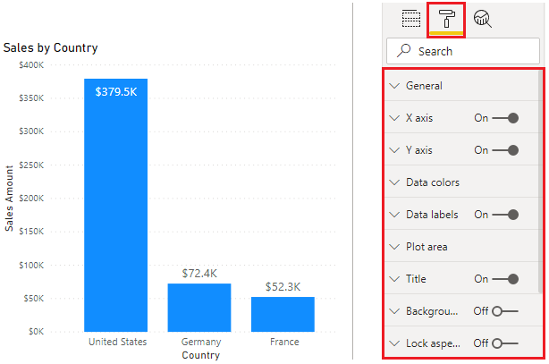
Format and Configure Visualizations
Control the look and feel of each visual.
Format options differ depending on the type of visual selected.
Notes:
Power BI Desktop gives you a variety of options for customizing how your selected visualizations look, such as the colors and format of the text that they contain. You should take time to explore the options to determine what impact they each have on a visual.
Common formatting options include:
Title: Add a title to the visual. The aim of the title is to clearly describe what data is being presented in the visual.
Background: Set any color or image as the background for the visual. It is best to keep a white background so the presented data can be clearly seen.
Border: Set a border around the visual to isolate the visual from other elements on the canvas.
General: If this section is available, you'll be able to set the precise size and place for your visual on your canvas. It can also be useful to ensure that you have aligned specific visuals consistently.
Data colors: Set the colors that you want to use for the data values in the visual. You can use different colors for different fields, but always try to be consistent when it comes to selecting those colors. It is best to use the same color scheme throughout the report.
Data labels: Change fonts, size, and colors for all labels in the visual. Try to use solid colors so the labels are clearly visible.
Tooltips: Add a customized tooltip that appears when you hover over the visual. Tooltips is a great feature because it provides more contextual information and detail to data points on a visual.

Slide 11
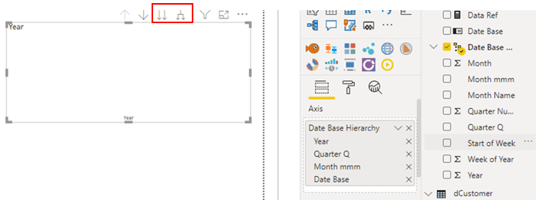
Basic Interactions
Use interactions to change how visuals impact each other.
Use hierarchies to drill down for additional relevant content.
Notes:
In Power BI Desktop your report is dynamic. When you make a selection on one visual in the report, other visuals might change to reflect that selection. Similarly, if there are hierarchies in your data, you can move up and down the hierarchy to see the data at different levels.
View Interactions:
When you have multiple visuals on the same report page, they all interact with each other, so you should become familiar with these interactions and see how your report changes. When you select an element in a visual, such as Components in the Product Category visual, the other visuals update to reflect your selection.
To enable visual interaction controls:
Select the visualization to make it active.
Click the Edit Interactions button to display the Visual Interactions options.
To display the visualization interaction controls, select Edit interactions. Power BI adds filter and highlight icons to all of the other visualizations on the report page.
<CLICK>
Use hierarchies:
A hierarchy is a structure in which groups are ranked one above the other, according to a specific status. For example, you could have a time hierarchy, with levels such as year, quarter, month and day, or a product hierarchy, with levels such as category, subcategory and product.
In regards to dates, Power BI creates hierarchies for you automatically. When you select the hierarchy in the Fields pane, the date hierarchy is added to the Axis field well on the Visualizations pane, and a blank visual is created for you, ready for additional fields.
When you add another field to the visual, the visual becomes useful, and you can then use the hierarchy icons to navigate through the hierarchy - Power BI creates a predefined drill path for the data.
Another navigation option is the Go the next level in the hierarchy button. When you select either hierarchy option, select the Drill up button to move back up hierarchy.
You can also predefine the hierarchy path for your report users, and remove the guess work from them. For example, you might want t prevent them from viewing a particular hierarchy level.
To do so, remove all of the fields from the Axis well, then in the Fields pane, right-click the field you want to set as the top level of the hierarchy, and then select New hierarchy. The new hierarchy displays ion the list in the Fields pane. You can now drag and drop other fields into the new hierarchy, or right-click each field and select Add to hierarchy.

Slide 12
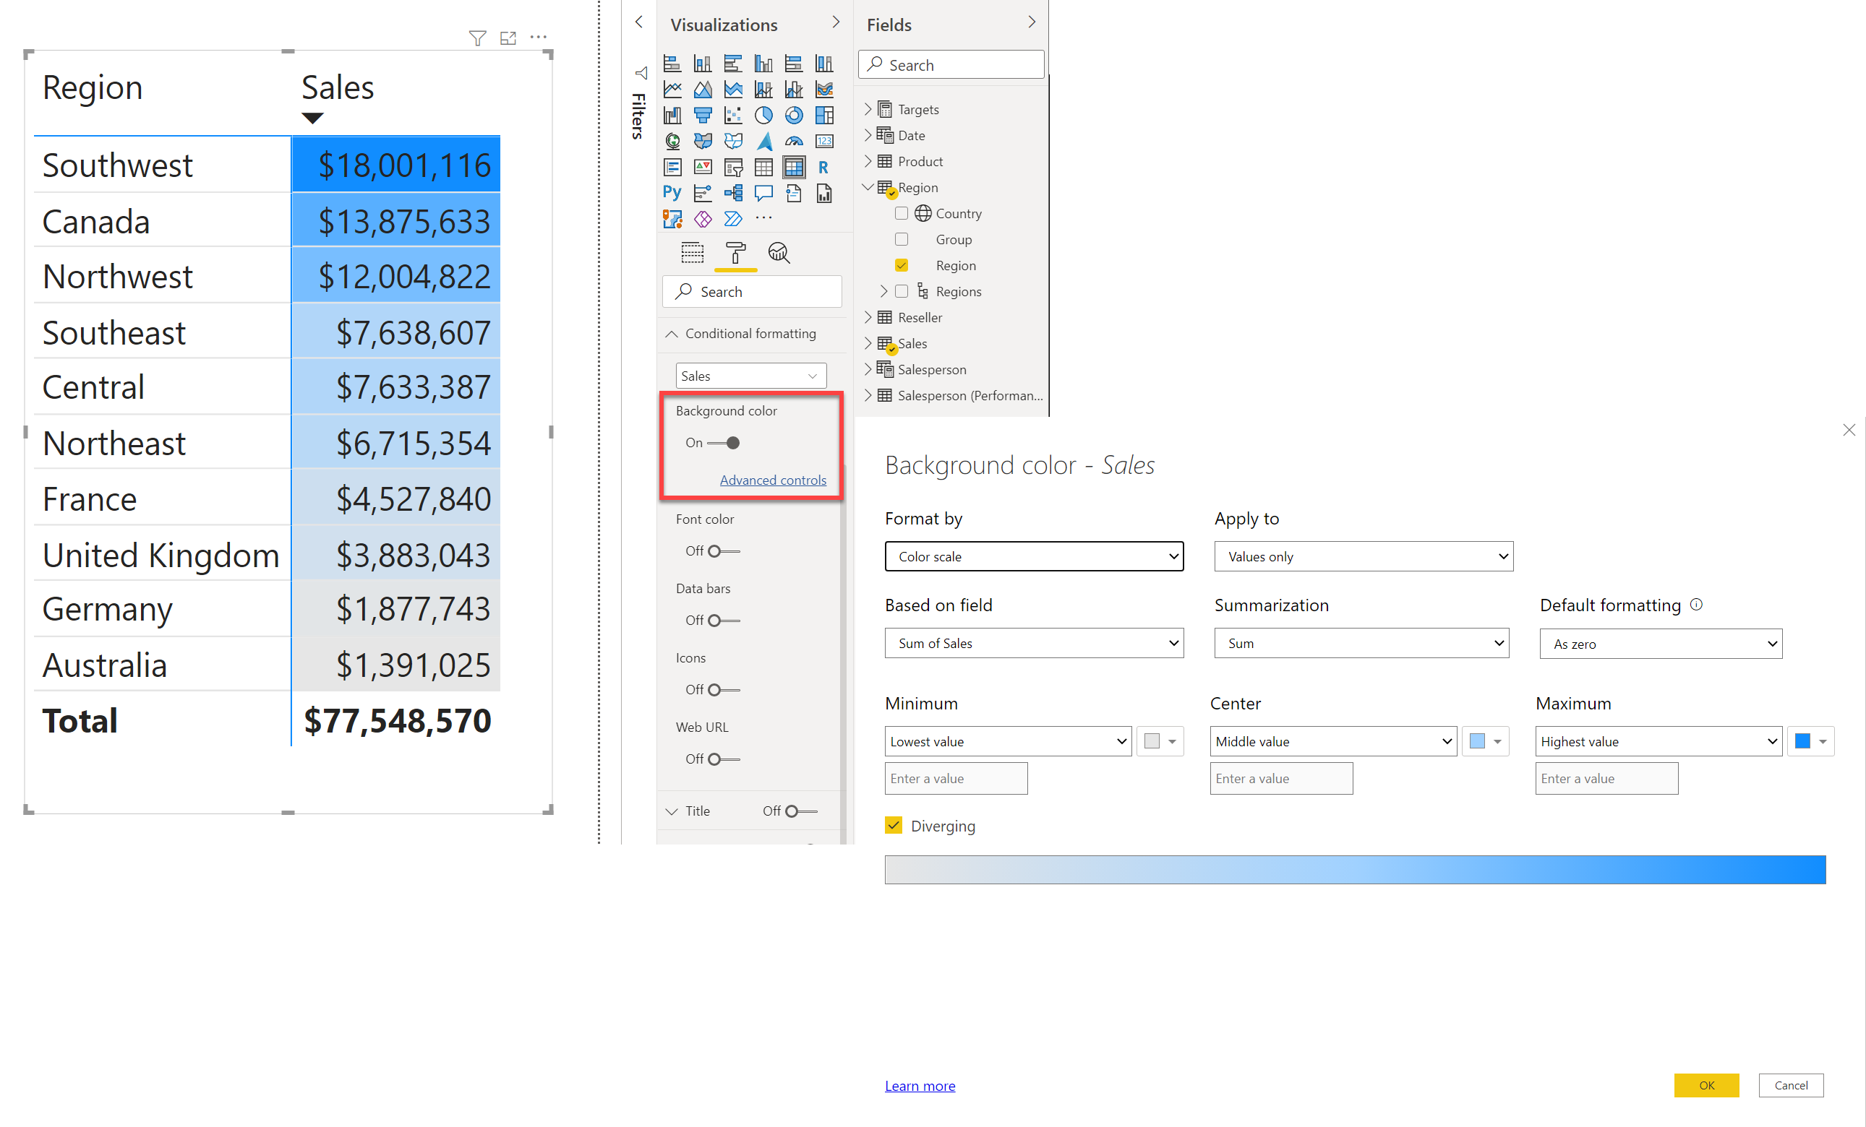
Configure Conditional Formatting
Notes:
Conditional formatting in Power BI Desktop allows you to specify customized cell colors, including color gradients, based on field values, or represent cell values with data bars or KPI icons, or as active web links.
You might want to use conditional formatting to highlight or differentiate the data that is displayed in your visual. This will allow you and other users to see key data insights at a glance.
For example, you could set up conditional formatting for your sales figures. If the sales amount falls below zero, you could display this in red, a color that is associated with danger, so users will see this clearly and know that they need to take action. Conversely, you could set a value for your sales target, then display amounts over that target amount in a green color, to signify that target is met and all is going well.
Conditional formatting is available in Power BI. Here we see it used in two visuals: Table and Matrix, where it is possible to set different conditions on a column. You can apply conditional formatting to any text or data field but the formatting needs to be based on a field that has numeric, color name or hex code, or web URL values.
The Power BI conditioning function will automatically detect highest and the lowest number in each column and apply background coloring according to the values.
If you want to remove the conditional formatting that you set, select the Values tab on the Visualizations pane and right-click the value (field) that you set the formatting against. Select Remove conditional formatting, then select the type of formatting you want to remove, for example All or Background color.

Slide 13
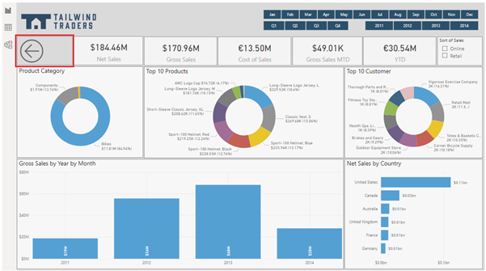
Design Report Navigation
Move users between pages.
Use buttons, bookmarks, or conditional formatting.
Notes:
Report navigation is the way in which your report users move from one page in your report to the next, move from one visual to another, and go back to where they started from. The design of your report navigation is very important because if users cannot easily find their way around your reports, they will become frustration and have a negative experience.
You can use a range of buttons and bookmarks when designing your report navigation, and you can further enhance this navigation experience with the use of conditional formatting.
Buttons:
To design the navigation within your report, you can create a new Navigation page in your report, and add navigation buttons there. You can also use a combination of both options. When users click on one of these buttons, they are brought directly to a different page within the report, which you can hide, so it can be only be accessed through the Navigation page buttons.
When you have set up the first navigation button, copy and paste that button to create the second navigation button, so you preserve the formatting you applied to the first button. Then change the title and destination for the second button.
Conditionally:
You can use conditional formatting to set the navigation destination based on the output of a measure.
Reasons to use conditional navigation:
To save space in your report. For example, rather than using multiple navigation buttons, you can use a single button to navigate to different pages based on the user's selection.
To specify the logical path that your report users should take. In other words, you determine the order in which users view each page.
To create a reporting portal where users can navigate to a set of reports.

Slide 14
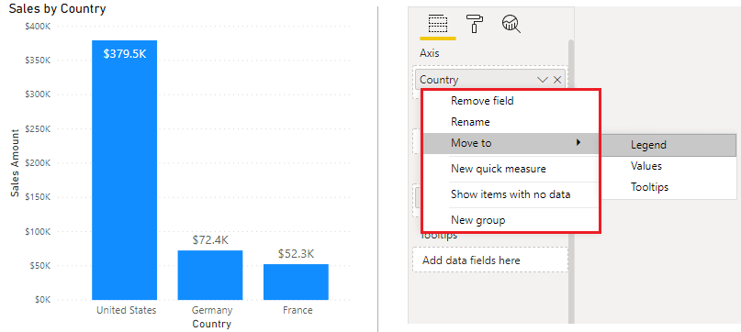
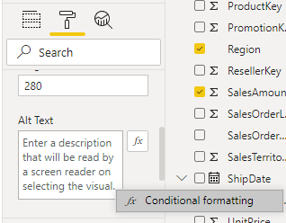
Design for Accessibility
The following accessibility features are built-in to Power BI Desktop:
Keyboard navigation
Screen-reader compatibility
High contrast colors view
Focus mode
Show data table
To improve the process of creating reports with screen readers, a context menu is available.
Design a report that adheres to accessibility standards and makes use of accessibility features.
Notes:
As mentioned in the introduction of this unit, it is important to consider that your end-users may have hearing, motor, cognitive, or visual impairments. You must design a report that adheres to accessibility standards and makes use of accessibility features that are available within Power BI Desktop.
Power BI is committed to accessibility standards under the Web Content Accessibility Guidelines. (WCAG) The standards help ensure that your Power BI experiences are accessible to as many people as possible. When you build accessible reports or dashboards, that content is accessible for anyone who views them using Power BI Mobile.
Designing a report that offers an accessible experience will benefit all report users, as it ensures your report has an effective design, and uses consistent formatting and a color scheme or theme.
In general, when using Power BI with a screen reader, it is recommended that you turn scan mode or browse mode off.
To improve the process of creating reports with screen readers, a context menu is available. The menu allows moving fields in the well up or down in the Fields list. The menu also allows moving the field to other wells, such as Legend or Value or others.
Standards:
The following are key principles of the Web Content Accessibility Guidelines:
Perceivable - Information and user interface components must be presentable to users in ways they can perceive.
Operable - User interface components and navigation must be operable.
Understandable - Information and the operation of user interface must be understandable.
Features:
The following accessibility features are built-in to Power BI Desktop, so you don't need to do any configuration in this regard:
Keyboard navigation
Screen-reader compatibility
High contrast colors view
Focus mode
Show data table
The following accessibility features you DO need to configure in Power BI:
Alt Text: To cater for report users that user screen readers, you can use alternative (Alt) text to describe the appearance and function of objects (such as a visual, shape, and so on) on the report page. Using alt text ensures that users understand what you are trying to communicate with those objects, even if they cannot see them
Tab Order: To help keyboard users to navigate your report in an order that matches the way visual users would, you can set the tab order.
Title and Labels: To help all users, you should add use clear, concise, descriptive titles for your visuals and report pages. Avoid using acronyms or jargon that new users or users who are external to your organization will not understand.
Themes: To make your reports even more accessible, you should ensure that there is enough contrast between the text and any background colors; the contrast ratio should be at least 4.5:1.

Slide 15
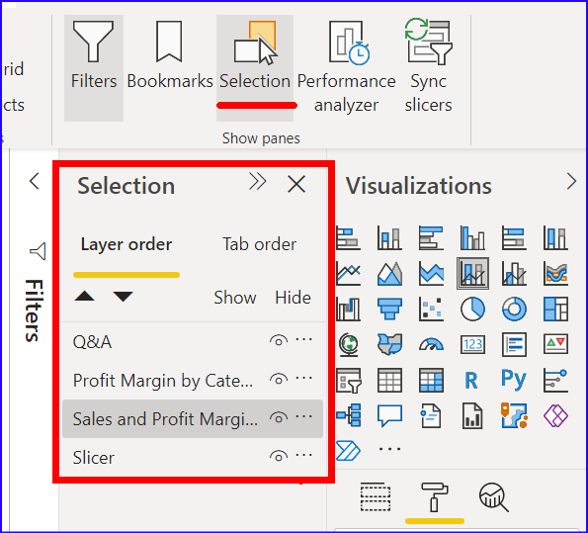
Design for Accessibility
People with people with vision impairments usually use Screen Reader.
A screen reader is an assistive technology, which converts text, buttons, images and other screen elements into speech or braille.
In Power BI
The following accessibility features are required to be configured.
Alt Text: To describe the appearance and function of objects (such as a visual, shape, and so on) on the report page. Its available in Format pane of visual in Power BI Desktop.
Tab Order: To help keyboard users to navigate your report in an order that matches the way visual users would. Available at View | Selection of Power BI
Title and Labels: To help all users, you should add use clear, concise, descriptive titles for your visuals and report pages.
Themes: Ensure that there is enough contrast between the text and any background colors; the contrast ratio should be at least 4.5:1
Notes:
As mentioned in the introduction of this unit, it is important to consider that your end-users may have hearing, motor, cognitive, or visual impairments. You must design a report that adheres to accessibility standards and makes use of accessibility features that are available within Power BI Desktop.
Power BI is committed to accessibility standards under the Web Content Accessibility Guidelines. (WCAG) The standards help ensure that your Power BI experiences are accessible to as many people as possible. When you build accessible reports or dashboards, that content is accessible for anyone who views them using Power BI Mobile.
Designing a report that offers an accessible experience will benefit all report users, as it ensures your report has an effective design, and uses consistent formatting and a color scheme or theme.
In general, when using Power BI with a screen reader, it is recommended that you turn scan mode or browse mode off.
To improve the process of creating reports with screen readers, a context menu is available. The menu allows moving fields in the well up or down in the Fields list. The menu also allows moving the field to other wells, such as Legend or Value or others.
Standards:
The following are key principles of the Web Content Accessibility Guidelines:
Perceivable - Information and user interface components must be presentable to users in ways they can perceive.
Operable - User interface components and navigation must be operable.
Understandable - Information and the operation of user interface must be understandable.
Features:
The following accessibility features are built-in to Power BI Desktop, so you don't need to do any configuration in this regard:
Keyboard navigation
Screen-reader compatibility
High contrast colors view
Focus mode
Show data table
The following accessibility features you DO need to configure in Power BI:
Alt Text: To cater for report users that user screen readers, you can use alternative (Alt) text to describe the appearance and function of objects (such as a visual, shape, and so on) on the report page. Using alt text ensures that users understand what you are trying to communicate with those objects, even if they cannot see them
Tab Order: To help keyboard users to navigate your report in an order that matches the way visual users would, you can set the tab order.
Title and Labels: To help all users, you should add use clear, concise, descriptive titles for your visuals and report pages. Avoid using acronyms or jargon that new users or users who are external to your organization will not understand.
Themes: To make your reports even more accessible, you should ensure that there is enough contrast between the text and any background colors; the contrast ratio should be at least 4.5:1.

Slide 16
Review Questions
Q01 – What is the benefit of using a report tooltip?
A01 – To provide additional detail that is specific to the context of the data that is being hovered over.
Q02 – Do you need to import custom visuals each time you want to use them when you are developing a new report?
A02 – Yes, custom visuals need to be imported from AppSource each time you start developing a new report unless you pin the custom visual to the visualizations pane.

Slide 17
Lesson Review
Visuals allow you to share data insights more effectively.
Using effective visualizations help users connect and interact with the information.

Slide 18
Lab: Design a Report in Power BI Desktop, Part 1
Lab06: Design a Report in Power BI Desktop, Part 1

Slide 19
Lesson 2: Enhance the Report

Slide 20
Introduction to Report Enhancement
Organizations rely on report information when making decisions.
Reports drive organizational behavior and action.
Notes:
Organizations use reports to monitor and record performance and identify trends and variances. Organizations rely on the information provided by reports when making decisions. Reports drive organizational behavior and action, at every level, in every aspect.
After you've added visuals to your report, you can make further improvements and fine tune the report before finally sharing it with the report audience. In this module, you'll apply the functions available in Power BI Desktop's report editor to your visuals, to transform your report into a data driven story. You'll provide users with a more effective report layout and navigation experience, and give them additional tools, so they can dive deeper into the information you present in your visuals. You'll then publish the report, so users can access the information they need to make decisions.

Slide 21
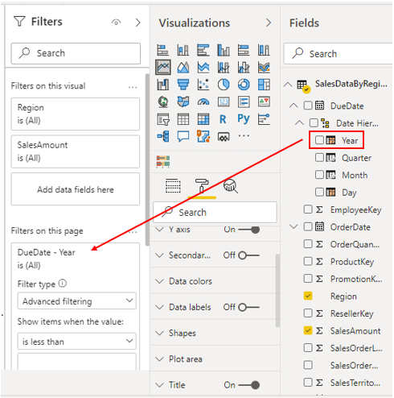
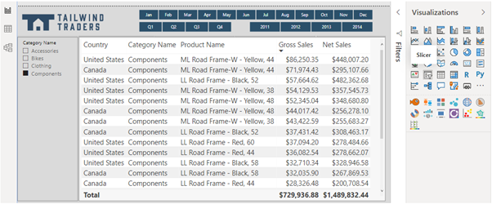
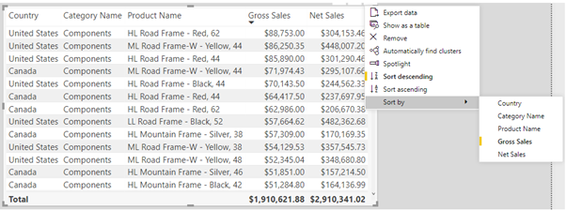
Apply Slicing, Filtering, and Sorting
Specifies
Notes:
Power BI Desktop provides three tools that you can use to edit and configure interactions between the visualizations you add to your report: slicers, filters and sorting.
The process of filtering allows you to remove all of the data you do not need, so you can focus on the data that you do need. You can apply filtering directly using the Filters pane, or by adding and using a slicer. Slicers and filters are similar, they both let you filter out the unnecessary data. You should try out both options to see which one is the best mechanism for your report situation. You might decide to use one option over the other, or use a combination of both.
Contrary to filtering, the process of sorting allows you to highlight the important information without removing any of the data.
Slicer:
A slicer is a type of filter that you can add to your report, so users can segment the data in the report by a specific value, such as by year or geographical location. The slicer narrows the portion of the dataset that is shown in the other visualizations in the report.
You might want to use a slicer to:
Provide quicker access to commonly used or important filters.
Make it easier to see the current filtered state without having to open a drop-down list.
Filter by columns that are unneeded and hidden in the data tables.
Create more focused reports (by putting slicers next to important visuals).
Defer queries to the data model by using a dropdown slicer, particularly when using DirectQuery.
To apply a slicer, select the Slicer icon in the Visualizations pane. Then in the Fields pane, select the fields you want to include in the slicer, or drag them into the slicer visualization.
The visualization turns into a list of items (filters) with check boxes that you can use to segment the data. When you select the box of an item, Power BI will filter (slice) all of the other visualizations on the same report page
<CLICK>
Filter:
While slicers are very useful, if you want to filter your data in a basic way, you do not need to add slicers to your report. Power BI Desktop has a Filter pane that can handle the basic slicer operations. Depending on your requirements, you might save time and effort by avoiding the use of slicers and simply using the Filter pane instead. This has the added benefit of reducing the total number of visuals on a report, which will improve performance.
As a report designer, you can customize the Filters pane in Power BI Desktop as follows:
Add and remove fields to filter on.
Change the filter state.
Format and customize the Filters pane so that it feels part of your report.
Define whether the Filters pane is open or collapsed by default when a consumer opens the report.
Hide the entire Filters pane or specific filters that you don't want report consumers to see.
Control and even bookmark the visibility, open, and collapsed state of the Filters pane.
Lock filters that you don't want consumers to edit.
To apply a filter, drag and drop a field from the Fields pane into the relevant section of the Filter pane.
<CLICK>
Sorting:
You can sort the data displayed in your visuals, so they display exactly how you want them to.
Sorting helps you to display the most important data in the most logical way, such as in alphabetical or numeric order. This basic task can help you to make big business decisions. For example, if you display products with the highest sales first, you help the end-user to see what product is the most popular among the customer base. Similarly, the products with low sales can be discontinued or replaced with new products, in order to increase revenue.
To sort a visual, start by selecting the More options (...) button in the upper-right corner of the visual. You have three sorting options:
Sort descending - Sorts the visual by the selected column in the order of greatest value to smallest value.
Sort Ascending - Sorts the visual by the selected column in the order of smallest value to greatest value.
Sort by - Sorts the data by a specific column. Hover over this option to display the list of columns that you can select from.

Slide 22
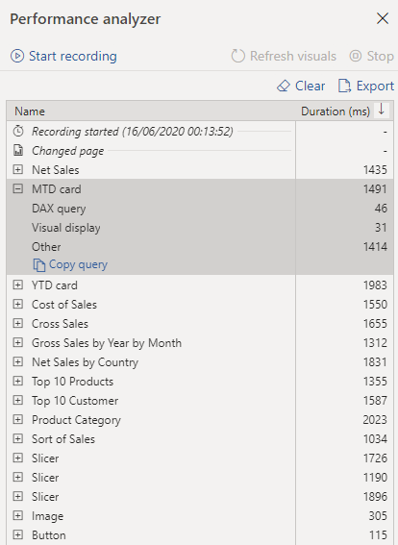
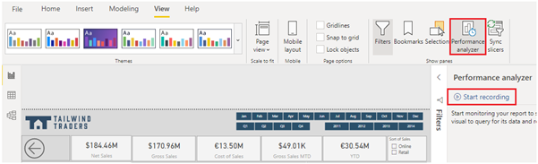
Performance Tuning Reports
The performance of a report depends on how quickly data can load into the report page.
Notes:
When you have completed creating your report, the performance of that report depends on how quickly data can load onto the report page. You should test out your report in the Power BI Report Server, to see how it works from an end-user perspective. If you experience any issues yourself, or if the report users have reported issues, you need to investigate the cause of those issues, and take measures to tune the report for more optimized performance.
Analyze Performance:
To investigate the cause of issues, your first port of call is the Performance analyzer tool within Power BI Desktop. Performance analyzer allows you to find out how each of your report elements and provides you with logs which measure (in time duration) how each of your report elements performs when users interact with them. By looking closely at the durations in the logs, you can identify which elements of the report are the most (or least) resource intensive. You can find where the bottlenecks are and this gives you a good starting point for making changes.
Before you run Performance analyzer, ensure you clear the visual cache and data engine cache, otherwise the results will not be accurate. Also, you should set up the report so that it opens on a blank page.
When you have cleared the caches, and opened the report on the blank page, to run the Performance analyzer, go to View tab, select Performance analyzer, and then select Start Recording.
Interact with your report as you would expect a user to, then stop the recording. You will see the results of your interactions displaying in the Performance analyzer pane as you work. When you are finished, select the Stop button. You can then analyze the results in the Performance analyzer pane. You will see the performance results of each item in the report, in milliseconds, under the Duration column.
Tune Performance:
The results of your analysis will identify areas for improvement and highlight items that you need to optimize.
A common reason for poor performance is too many visuals on the same page. In the following image you can see an example of a busy page that contains many visuals.
If you identify visuals as the bottleneck leading to poor performance, you can take the following steps to tune the report:
Reduce the number of visuals on the report page; fewer visuals means better performance. If a visual is not necessary and does not add value to the end user, should remove it. Rather than using multiple visuals on the page, consider other ways to provide additional details, such as drillthrough pages and report page tooltips.
Reduce the number of fields in each visual. The upper limit for visuals is 100 fields, so a visual with more than 100 fields will be slow to load (and look cluttered and confusing). Identify fields that are not valuable to the visual and remove them.
If you find that visuals are not causing the performance issues, you should take a close look at the DAX Query results that are displayed in the Performance analyzer pane, and investigate further into those.

Slide 23
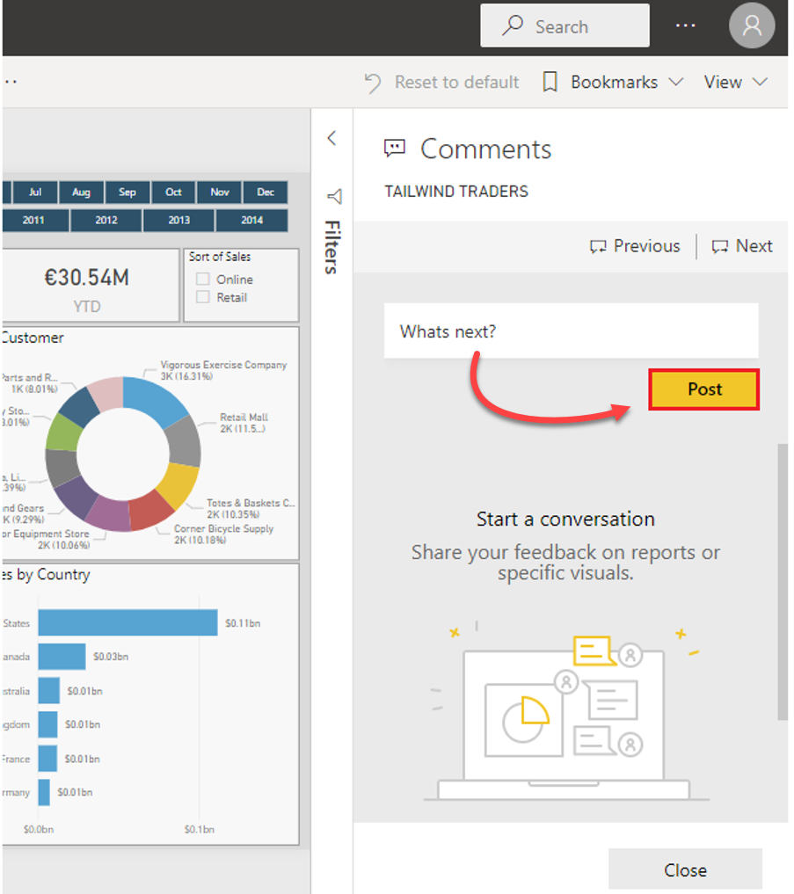
Commenting on Reports
Used for personal comments or for collaborating with a colleague.
Available for paginated reports, dashboards, and visuals.
Anyone with permissions can see comments.
Notes:
When you publish your report to Power BI web service, the consumers (users) of your report can add comments to the report. Comments can be useful for personal comments or for starting a conversation about a report item with your colleagues. For example, users can comment on pages or visuals that are experiencing issues with or they could give you suggestions for changes or improvements.
Comments are also available for paginated reports, dashboards and visuals. Anyone with the right permissions can see those comments. When you add a comment to a specific visual rather than the report as a whole, the context of the comment is more clear, and acts like a personal bookmark.
To add or view comment on a report, open the report in the Power BI web service. In the upper-right corner, select Comments. In the Comments pane, you can see any existing comments and write your own comments, then select Post Comment.
To add a comment from a visual, select the visual in the report to open that visual in focus mode. Then select Comments from the top menu, and type your comment in the Comments pane that displays.

Slide 24
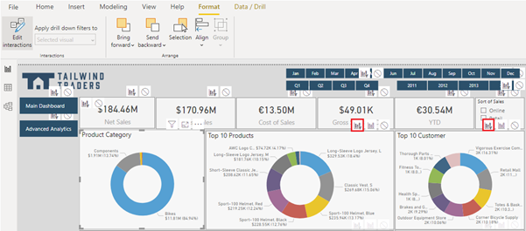
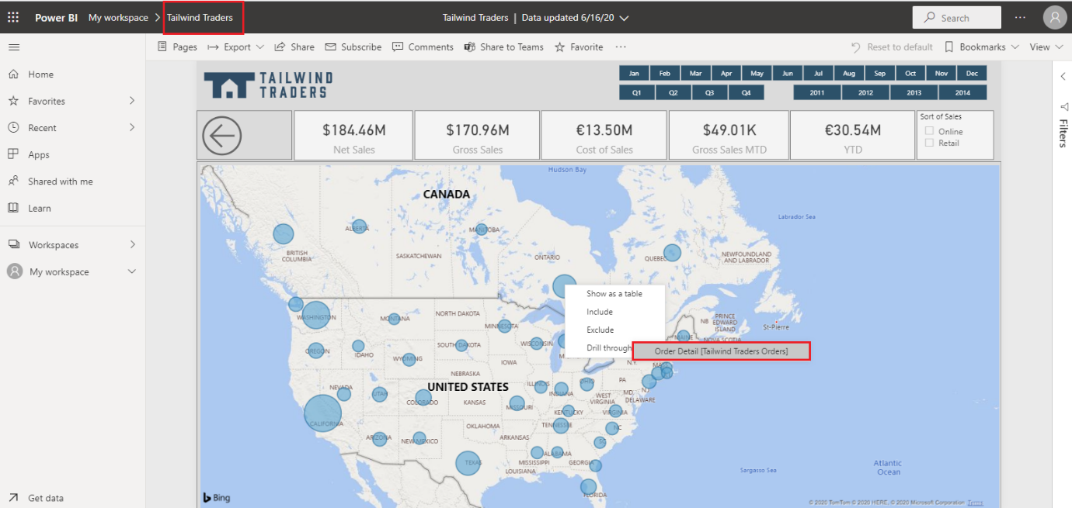
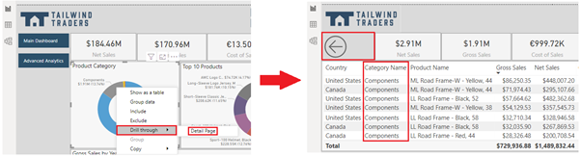
Advanced Interactions and Drill-Throughs
Notes:
To ensure you have full control over the behavior of your report and can determine the expected user experience, you can edit the default interactions and use the drill-through features.
Edit interactions:
You can use visual interaction controls to customize how the visualizations on your report page impact each other, in order words, filter and highlight each other.
For example, when you select an item in a visual, the other visuals update to display data for that item. They might be highlighting or filtering the selected data. You can stop this from happening, or change a highlight action to a filter action and vice versa.
To enable the visual interaction controls, select a visualization then go to the Format tab in the ribbon and select Edit interactions.
To change an interaction of a selected visual, select the required interaction icon. Remember, the applied interaction is bold. In the following image:
The selected interaction is cross-highlight because the Highlight icon is bolded.
You can change the interaction to cross-filter by selecting the Filter icon.
You can remove the interaction altogether by selecting the None icon.
Keep in mind that the number of interactions between your visuals will impact on the performance of your report. To optimize the performance of your report, you should consider the query reduction options that are available within Power BI Desktop.
<CLICK>
Drill through:
You can use the drill through feature to create a page in your report that focuses on a specific entity, such as a product, category, or region. You can then access this page when you drill through from the related visuals that are on other pages in your report. The information that displays on the drill through page will be specific to the item you select on the visual.
In this example, you create a drill through for the product category entity. You start by creating a page in your report and rename it to Detail Page. On that page, you add a visual for the entity that you want to provide the drill through for.
Then, from Values section of the Visualizations pane, drag the field (Category Name) for which you want to enable drill through into the Drill-through filters.
Power BI Desktop automatically creates a Back button visual on the page for you. This button is for navigation purposes, so your report users can get back to the report page from which they came.
<CLICK>
Cross-report drill through:
The Cross-report drillthrough feature allows you to contextually jump from one report to another report in the same Power BI service workspace or app, so you can connect two or more reports that have related content. You can also pass filter context along with that cross-report connection.
For example, you can select a data point on a visual in one report, then drillthrough to related, detailed information that is in another report.
To enable cross-report drillthrough, you first need to validate the data models for the source and target reports. Although the schemas in each report don't have to be the same, both data models must contain the fields you want to pass.
NOTE: You need to enable the Cross-report drillthrough feature in Power BI Desktop. The Cross-report drillthrough feature can also be enabled/disabled in the report settings in the Power BI Service.

Slide 25
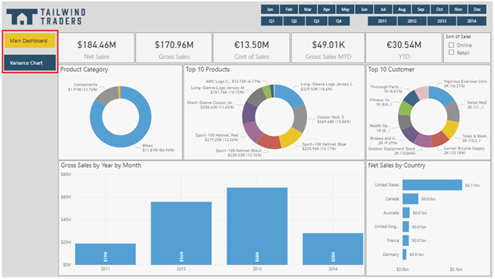
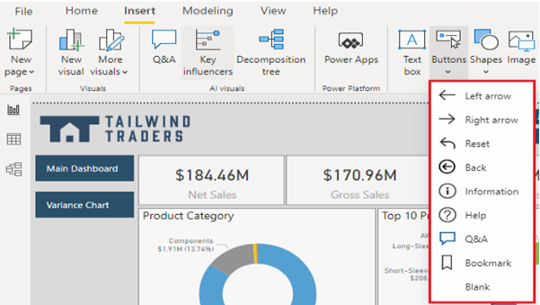
Adding Buttons, Bookmarks, and Selections
Notes:
You can use the Bookmarks, Buttons and Selections features in Power BI Desktop to make your report more interesting and interactive, and easier for users to navigate.
Bookmarks capture the currently configured view of a report page, so you can quickly return to that view later. You can use bookmarks for different reasons. For example, you can use them to keep track of your own progress when you are creating reports. You can also use them to build a PowerPoint-like presentation that goes through the bookmarks in order, thereby telling a story with your report.
Buttons create a more interactive experience for the report users. With the addition of buttons that have assigned actions, your report behaves similar to an app, where users can hover, click, and interact more with the content.
Selections allow you to determine what items in the report are visible and what items are hidden. Selections are used alongside bookmarks and buttons.
Bookmarks:
When you add a bookmark, the following elements are saved with the bookmark:
Current page,
Filters, slicers, sort order
Drill location
When you have added and formatted all of the visuals and other items on the page, you can add a bookmark to capture a snapshot of the page in its current state. Add multiple bookmarks and switch between the bookmarks.
<CLICK>
Buttons:
You can use buttons for many reasons, such as to switch between two visuals in a report (as required in the previous example), to drill-down into the data in a visual or to move from one page in your report to another. Power BI Desktop provides a range of types of buttons you can add to your report, as illustrated in the following image.
The options for the button action types are the following:
Back - Returns the user to the previous page of the report. This option is useful for drill-through pages or pages that are all accessed from one main page.
Bookmark - Presents the report page that's associated with a bookmark that is defined for the current report.
Drill through - Brings the user to a drill-through page that is filtered to their selection, without using bookmarks.
Page navigation - Brings the user to a different page within the report, also without using bookmarks, which is an effective way to create a navigation experience for your report users. You will take a closer look at this type of button in the next unit.
Q&A - Opens a Q&A Explorer window, which allows users to type questions to quickly find the information they are looking for, and specify the type of visual they want to see that information displayed in. This option can be useful if you want to save space in the report but still offer Q&A functionality to the user.
Web URL - Opens a website in a new browser window. For example, you might want to give users quick access to your organization's website or Intranet from within a report.

Slide 26
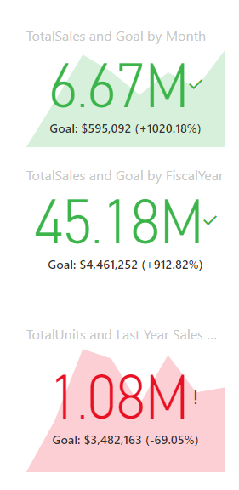
Key Performance Indicators
An excellent source in helping track toward a specific goal over time.
Best when used in a series (e.g., daily, monthly, etc.).
Notes:
Key performance indicators (KPIs) are excellent in helping you track progress toward a specific goal over time.
To use a KPI, you need three pieces of information:
A unit of measurement that you want to track, for instance total sales, number of employee hires, number of loans serviced, or number of students enrolled.
A goal for the measurement so that you can compare your progress with that goal.
A time series, for instance daily, monthly, or yearly.
KPIs work best in a series, for instance, showing the daily, monthly, and yearly goals in the section of a Power BI report.
Start by adding the KPI visual to the design service. The following screenshot shows the KPI icon in the Visualizations pane.
When configuring the KPI visual, enter the unit of measurement that you are tracking in the Indicator prompt. Then, enter the goal under Target goals and select the time series from the Trend axis drop-down list.

Slide 27
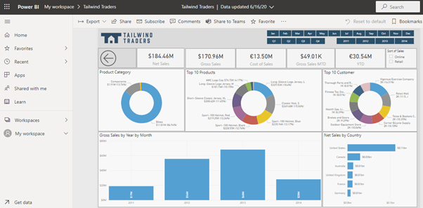
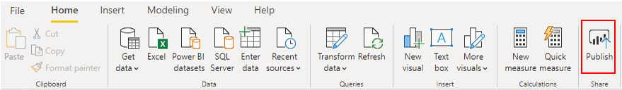
Publish and Export Reports
Notes:
When you are finished designing your report, you can publish the report to your Power BI workspace. There are also options to export to Microsoft Excel.
When you publish a report, Power BI Desktop packages your report and data, including all your visualizations, queries, and custom measures, and uploads them to the Power BI service.
To publish your report, select the Publish button on the Home tab.
You might also be required to sign in to Power BI, in which case, enter your sign in credentials to continue.
On the Publish to Power BI window, select the destination in which you want to publish the report. For example, you can publish to a workspace within Power BI. For production reports, it's recommended to publish to an App Workspace.
When the report is successfully published, you'll get a success message that contains a link to your report in your Power BI site. Select Got it to close the Publishing to BI window and return to your report in Power BI Desktop. From here, you can click on the URL provided to navigate to the Power BI Service and see your new report.
Export reports
Power BI allows you to export visual data, reports, and datasets. You can export to several different formats including CSV, Excel, and PDF.

Slide 28
Review Questions (1)
Q01 – Which filter is not available in Power BI reports?
A. Page Level B. Report Level C. Visualization D. Page Type
A01 – Page Type
Q02 – How can you analyze performance of each of your report elements?
A02 – By using performance analyzer.
Q03 – Can you use bookmarks to create a slide show in Power BI?
A03 – Yes, you can.

Slide 29
Lesson Review
Organizations rely on report information when making decisions.
Reports drive organizational behavior and action.

Slide 30
Lab: Design a Report in Power BI Desktop, Part 2
Lab 07: Design a Report in Power BI Desktop, Part 2

